Slide 1


Communication Design
# LAB.2 Signal Processing Overview
Ass.Lec.Ammar Alabbassi

Slide 2
Outline:
Signal Processing Overview
Generate Signals
Import Signals
View Power Spectrum
Compare Signals

Slide 3
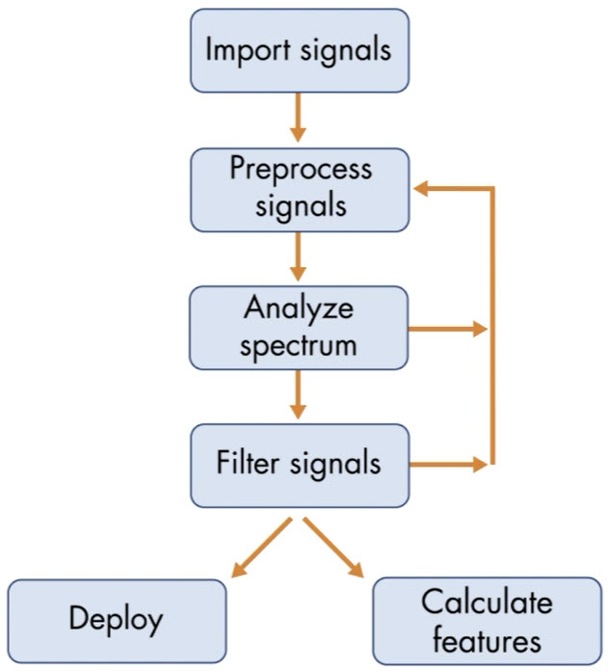
Signal Processing Overview
Generate signals.
Import the signals into MATLAB.
Preprocess the signals in the time domain to prepare them for analysis
Look at the power spectrum in the frequency domain
Filter the signals to keep only relevant frequency content
Revisit earlier steps in the process to refine your algorithm
Extract information from the signals or deploy your algorithm to hardware
Generate signals

Slide 4
Generate Signals

Slide 5
Task 1
To generate a signal, you first choose the sample times for each point of the signal. You can choose sample times by specifying the following:
• Sample rate fs in Hertz (Hz)
• Start time in seconds
• End time in seconds
You can create time steps from a to b with the colon operator:
a:1/fs:b
# TASK
Specify a sample rate of 100 Hz in a variable named fs. Then create a signal named t that extends from 0 seconds to 1 second, with time steps that are 1/fs.
fs=100;
t=0:1/fs:1;

Slide 6
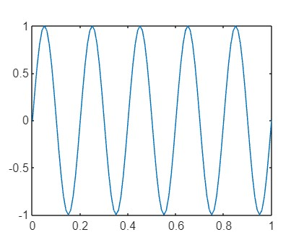
Task 2
A straightforward way to make a sine wave is using the sin function:
s = sin(2*pi*f*t)
where f is the signal's frequency, and t are the time steps.
# TASK
Create a 5 Hz sine signal named sig at the sample times in t. Then create a plot of sig versus t.
sig = sin(2*pi*5*t);
plot(t,sig)

Slide 7
Task 3
It is common to add noise to generated signals. Noise makes the signals more realistic and helps you to test if your signal processing techniques are robust to noisy data. To add noise, you can create a vector of random numbers that is the same size as your signal s:
randn(size(s))
#TASK
Create a vector of normally distributed random numbers named noise that is the same size as sig. Multiply the vector by 0.1 to scale the vector.
noise=0.1*randn(size(sig));

Slide 8
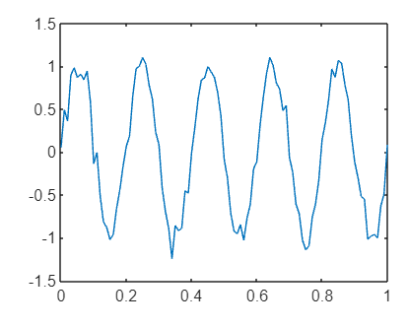
Task 4
#Task:
Add the signal vector with the noise vector. Name the output sigNoisy. Then create a plot of sigNoisy versus t.
sigNoisy = sig + noise;
plot(t,sigNoisy)

Slide 9
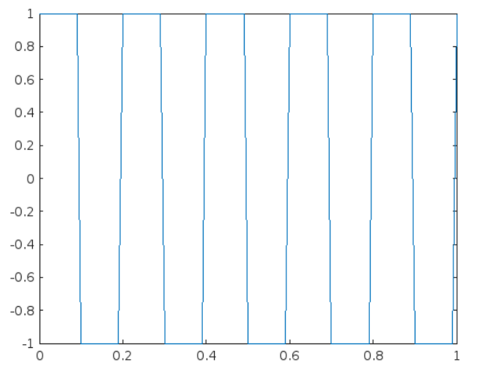
Task 5
Signal Processing Toolbox contains functions for common waveforms, like the square and sawtooth functions. The inputs are similar to the sin function:
s = square(2*pi*f*t) f is the frequency and t is a vector of time steps.
#TASK
Create a square signal named sq at the sample times in t. Use a frequency of 5. Then create a plot of sq versus t.
sq = square(2*pi*5*t);
plot(t,sq)

Slide 10
Import Signals

Slide 11
Task 1
In this task, you will process the seismic signals in the Signal Analyzer app. The seismic stations record the vertical displacement caused by vibrations in the Earth's crust. First, you need to import the signals into the Workspace. The readmatrix function imports a numeric matrix from a file.
M = readmatrix("mynum.txt")
In this activity, you import the signal recorded at the HARP seismic station. The signal is stored in the file "harp.csv".
# TASK
Import the seismic signal stored in "harp.csv" to a vector named harp. Then plot the harp signal.
harp = readmatrix("harp.csv")
plot(harp)

Slide 12
View Power Spectrum

Slide 13
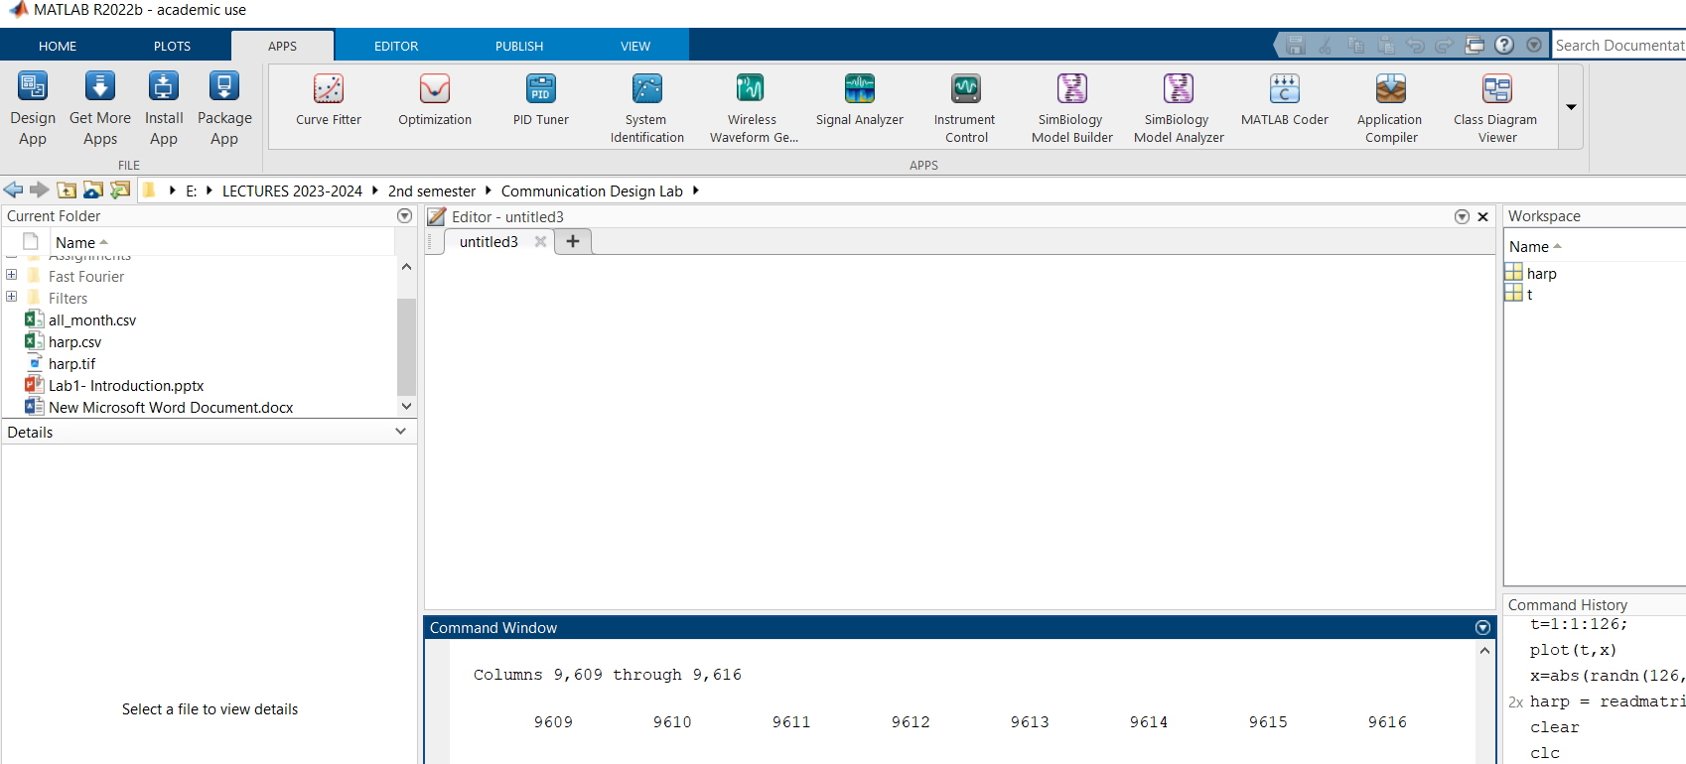

Slide 14
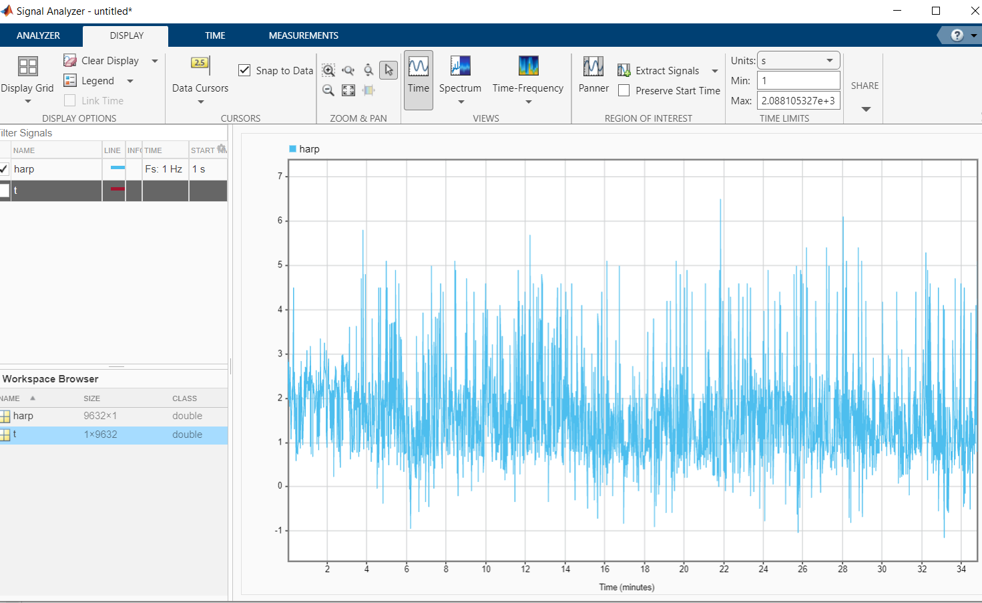
Task 1
The Workspace Browser within Signal Analyzer contains any signals stored as numeric arrays or variables with inherent time information like timetables.
You can visualize signals by dragging them from the Workspace Browser to the axes.
#TASK
Drag the harp signal from the Workspace Browser to the axes to display it.

Slide 15
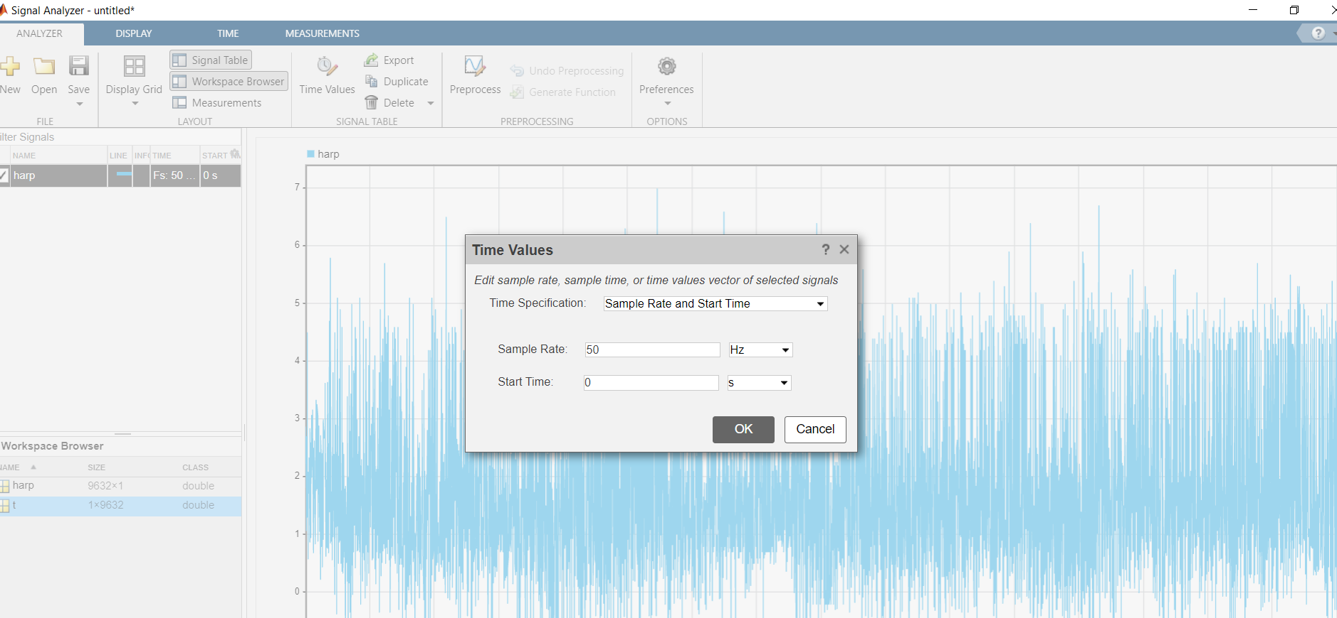
Task 2
To set the time information, select Time Values in the Analyzer tab. You can specify the sample rate (fs), the time between each sample (1/fs), or a vector of time values.
#TASK
Set sample rate to 50 Hz. (In the Time Specification drop down, select Sample Rate and Start Time).

Slide 16
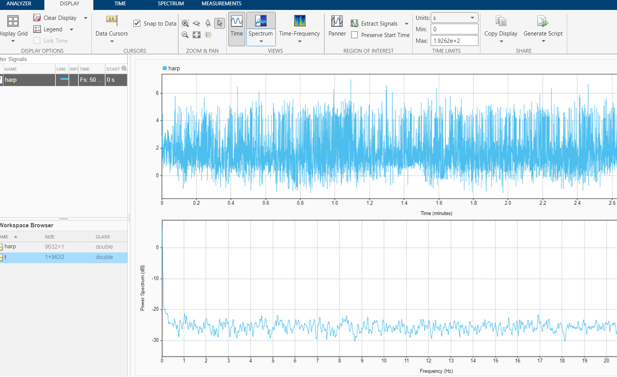
Task 3
To view the frequency content of a signal, you can display its power spectrum by clicking Spectrum on the Display tab.
#TASK
Display the power spectrum of the harp signal.

Slide 17
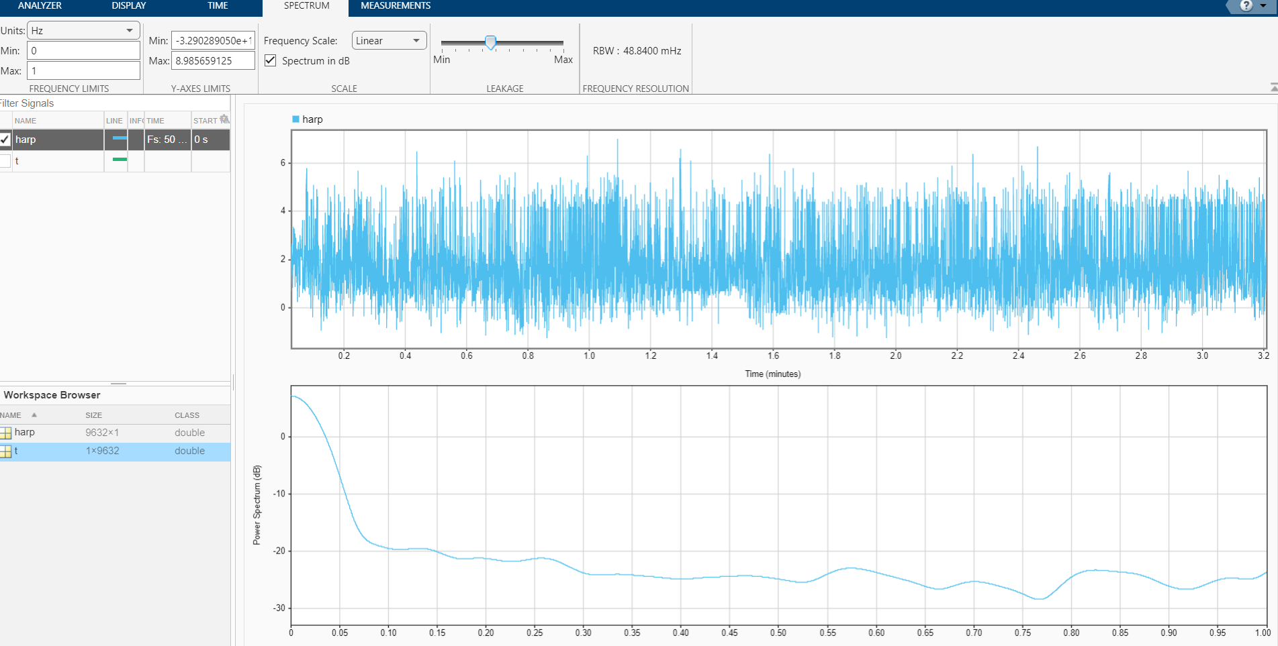
Task 4
While you display the power spectrum, a Spectrum tab contains options to customize the visualization.
The frequency range of these seismic surface waves is small, so to focus on the meaningful seismic activity, you can set the frequency limits of the power spectrum.
#TASK
Set the frequency limits from 0 Hz to 1 Hz.

Slide 18
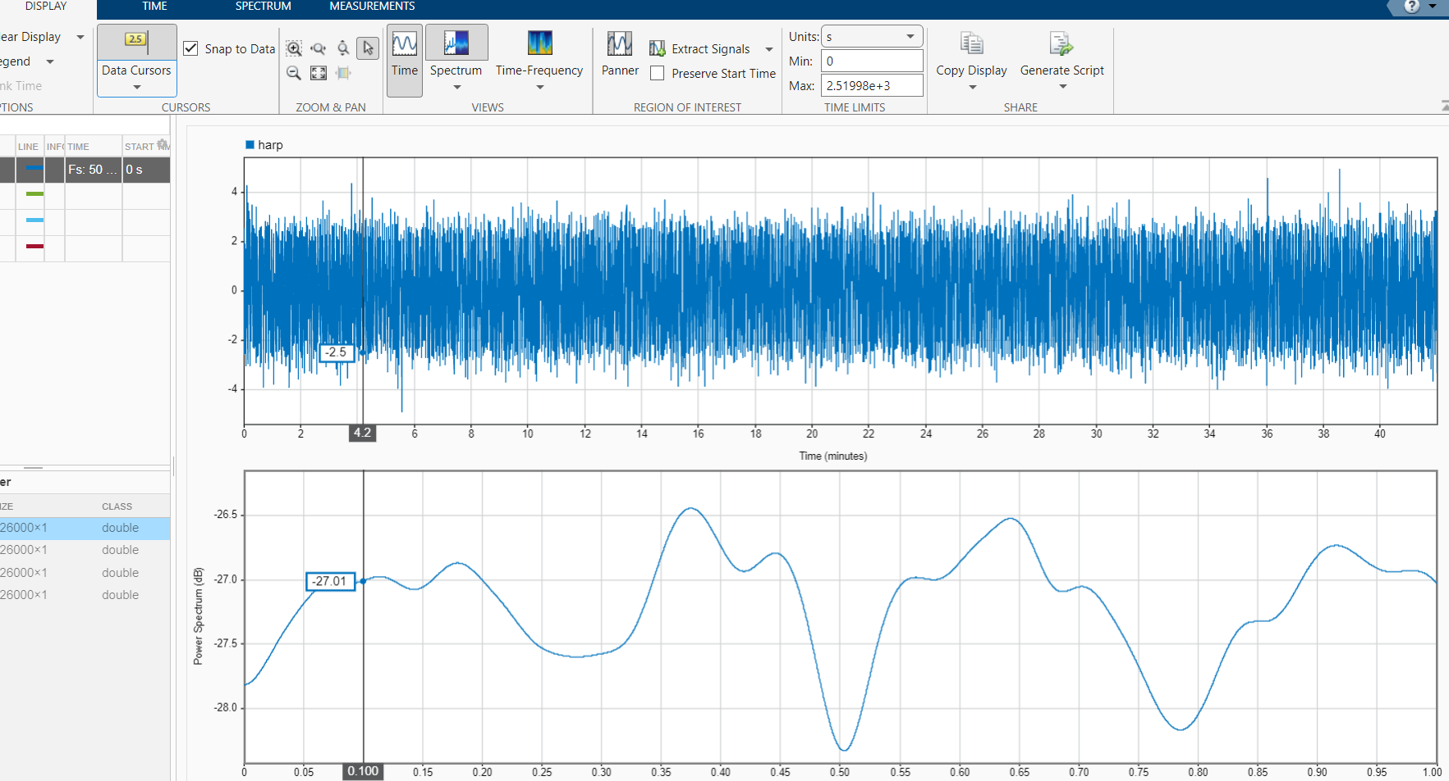
Task 4
Try adding a data cursor to look at the frequency location of the peak. You can add a data cursor in the Cursors section of the Display tab.

Slide 19
Compare Signals

Slide 20
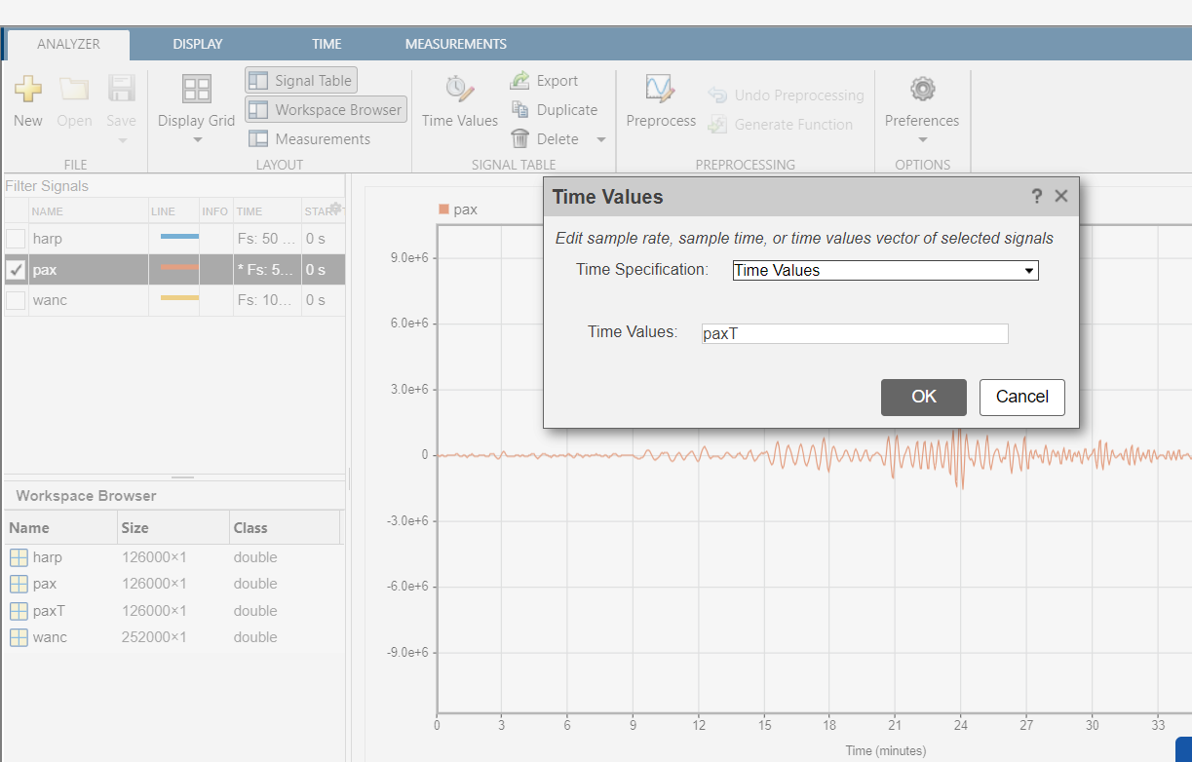
Task 1
1-The three seismic stations HARP, PAX, and WANC collected the seismic signals using different hardware. As you've seen, the data from the HARP station was sampled at 50 Hz.
2-The data from the PAX station was also sampled at 50 Hz, but the hardware was imperfect, so the spacing between each sample wasn't exactly 0.02 seconds. Since the time information of the signal isn't evenly spaced, the time information at every sample needs to be specified.
3- You can specify a vector instead of a sample rate using the Time Values time specification.
#TASK
Select the pax signal in the Signal table. Use the Time Values button to add time information using the vector paxT. Then display the signal.

Slide 21
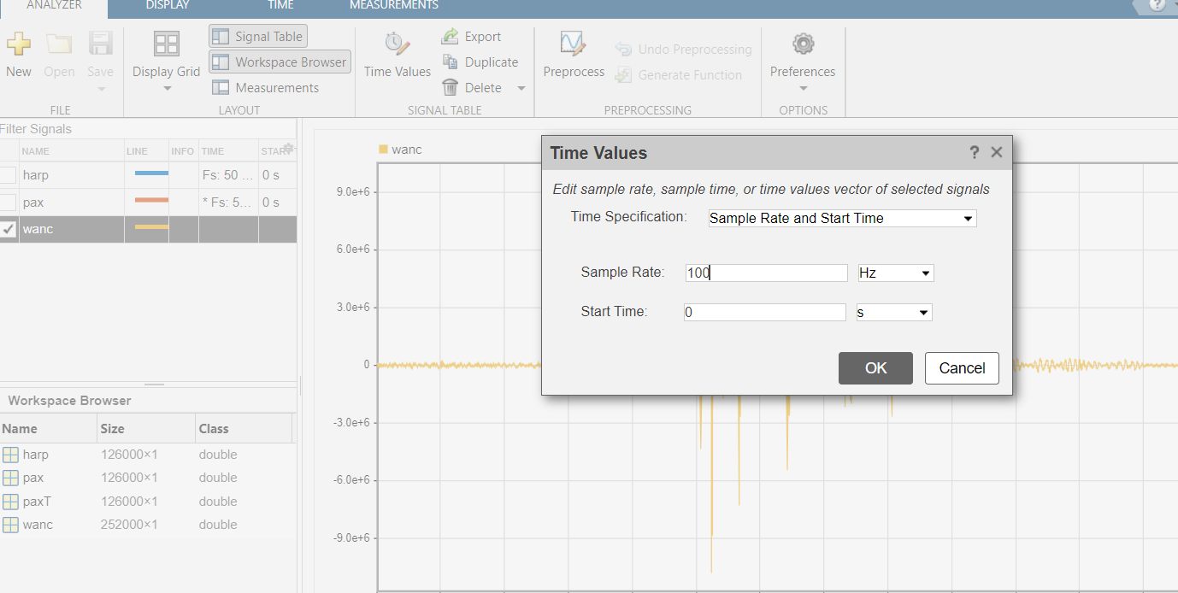
Task 2
The signal from the WANC station is uniformly spaced, but it was sampled at a faster sample rate of 100 Hz.
#TASK
Set the sample rate of the wanc signal to 100 Hz and display the signal.

Slide 22
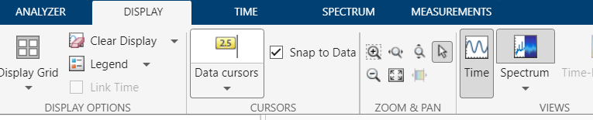
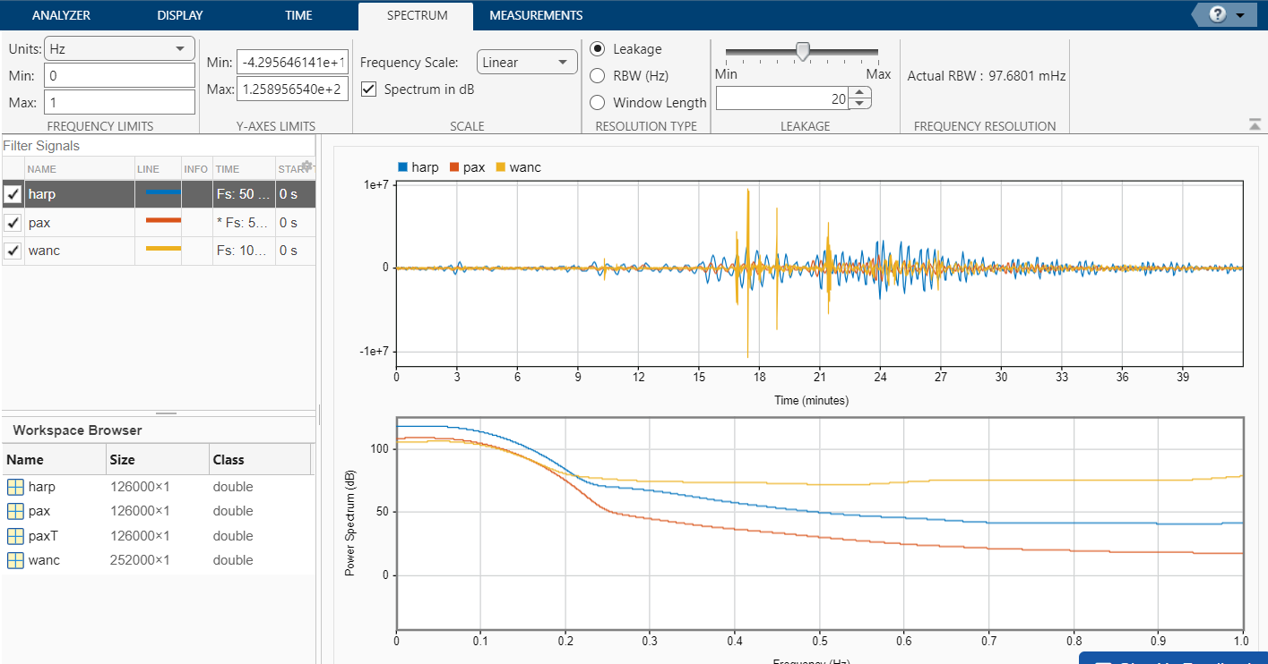
Task 3
The different signal amplitudes make it difficult to compare the signals in the time domain, but you can still compare them in the frequency domain.
#TASK
Display all three signals, then display the power spectra. Set the frequency limits from 0 to 1 Hz.

